Slide 1
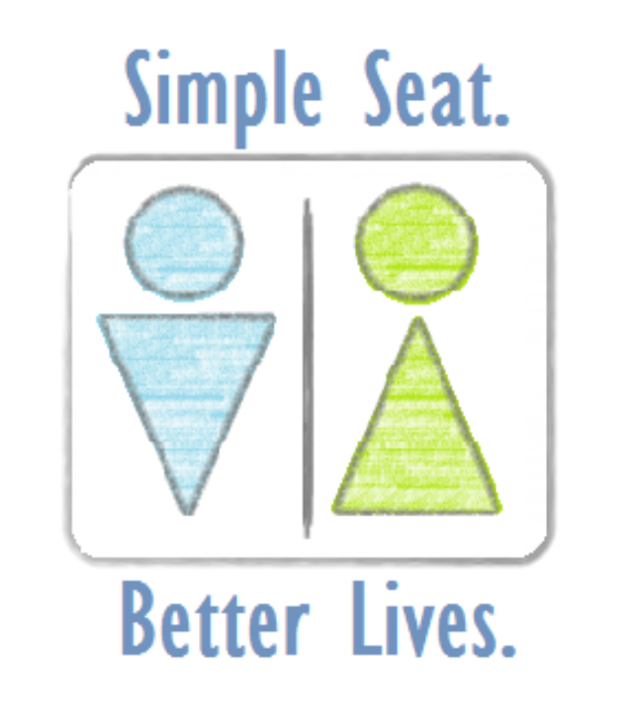
Helping Landmine Survivors in Uganda
By: Mei-Li Hey

Slide 2
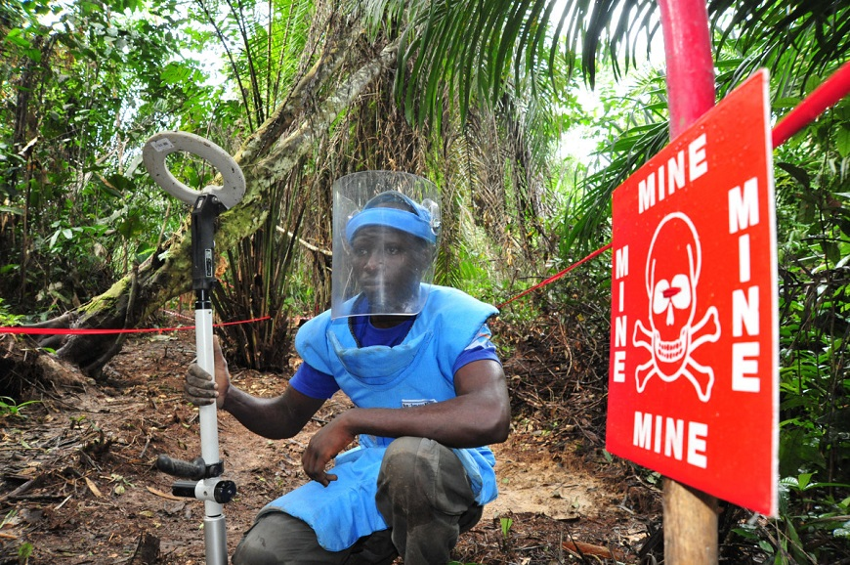
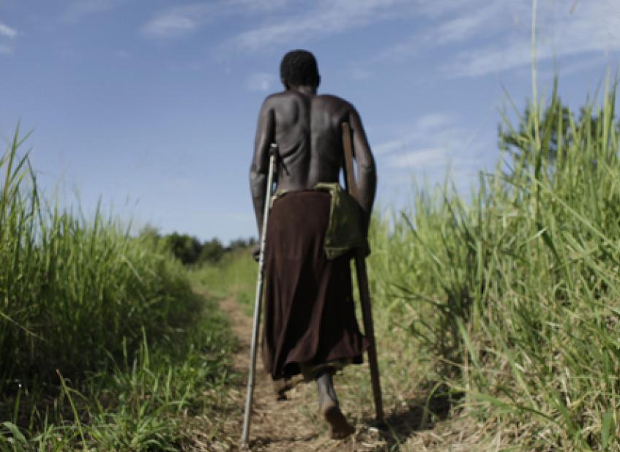
Background on the Issue
A nation recovering from decades of war
War creates disability. Disability feeds poverty. Poverty creates conflict.
Cultural barriers for those with disabilities:
"When you reach a family with a disabled child, the parents say, ‘We have four children and one disabled. The disabled child is not part of the family, they are an unfortunate addition,” – Teddy.
/

Slide 3
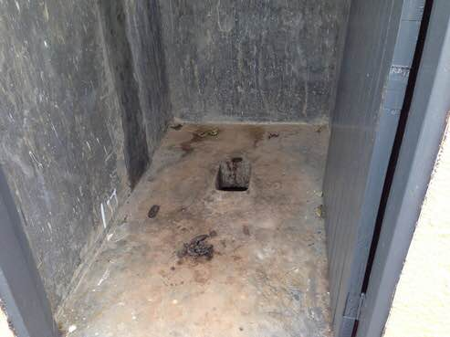
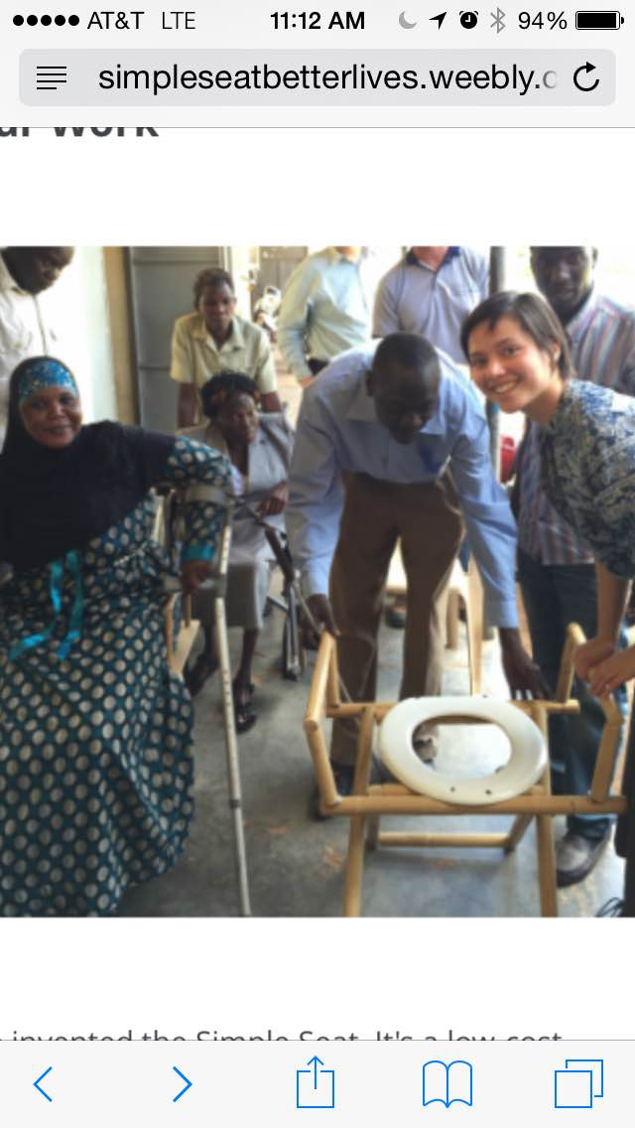
Purpose of the Simple Seat
The goal of this project is to address the problem concerning the use of pit latrines in Uganda by individuals who have been handicapped by landmines. The objective is to design portable, low-cost assistive devices that solve physical and socially stigmatic problems for handicapped individuals. Since the typical facility in Uganda is a pit latrine, handicapped individuals are unable to squat or stand up independently. This leads to sanitation issues, as well as embarrassment.
A standard Ugandan pit latrine
Meeting with the District Union of Disabled Persons in Uganda

Slide 4
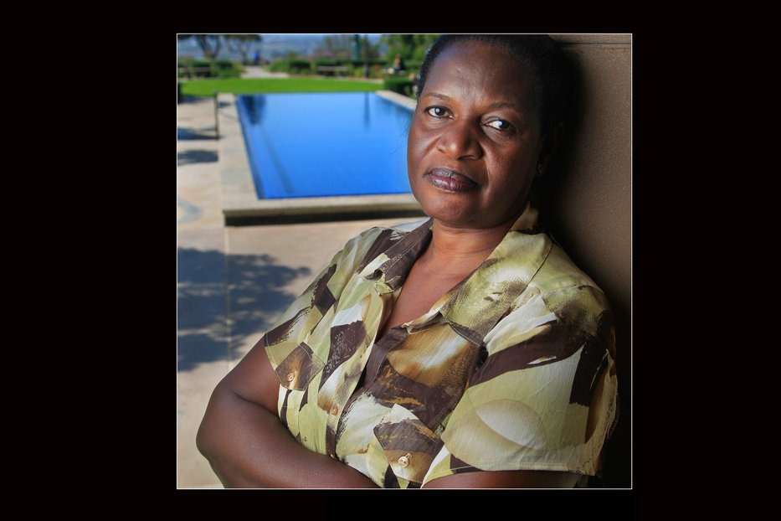
Margaret’s Story

Slide 5
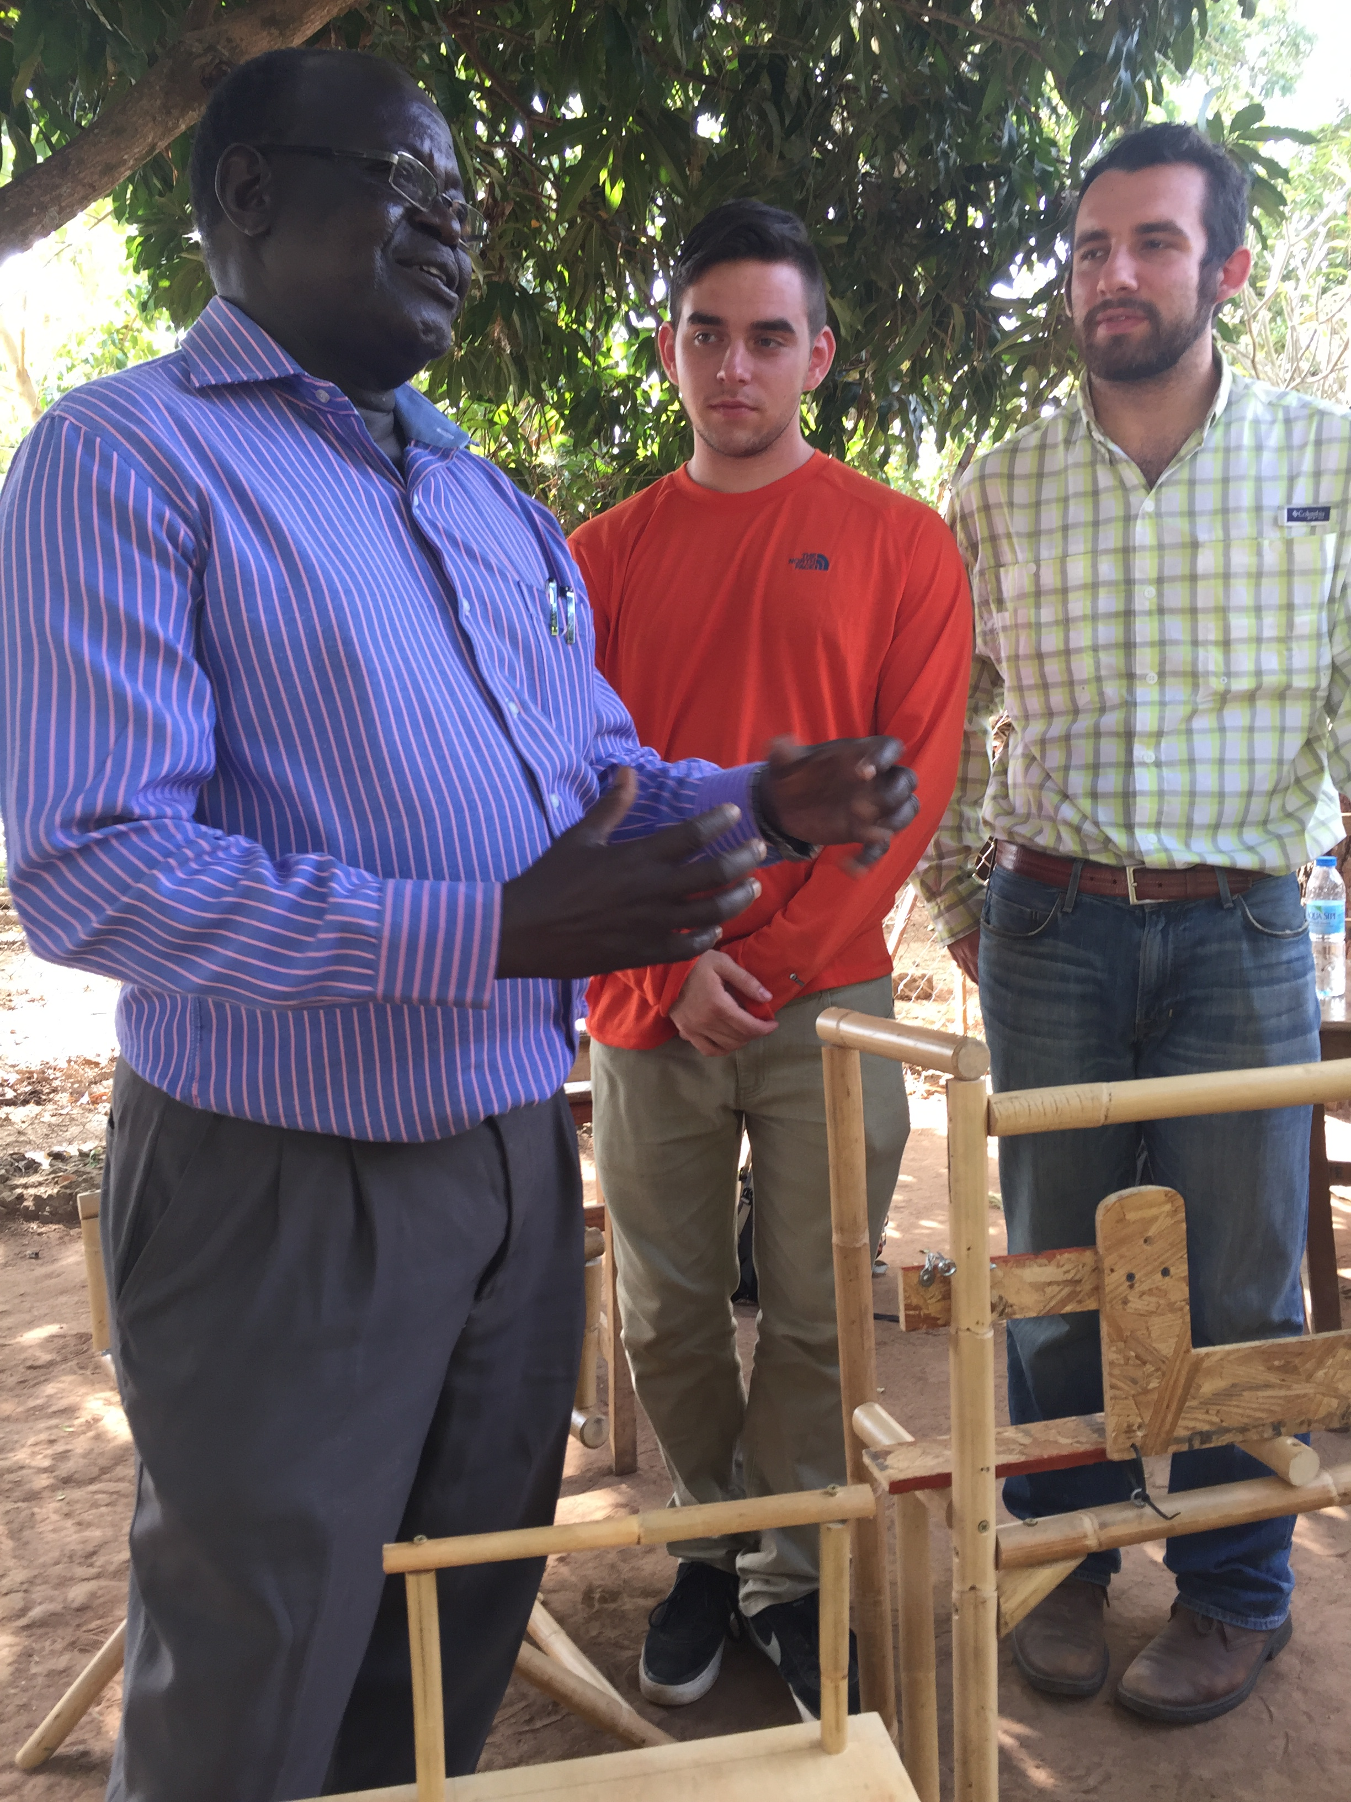
The Impact is
Two-Fold
The Simple Seats will be made IN Uganda BY Ugandans.
Benefits to this system:
Creating Jobs
Fighting negative social stigma of the disabled community
The Simple Seat will be able to reach more users.
Our team speaking with the Principal of Ave Maria

Slide 6
The Solution is Complex
Design Limitations:
Materials used to build the seat (i.e. wood (two by fours and ¾” wood board), hinges, screws, nails, rope and simple braces.
Tools used in production (i.e. saw, drill, hammer)
Cost of Materials
Social Limitations – negative stigma of being disabled along with carrying around a toilet seat

Slide 7
The Solution is Complex
Further Design Optimizations:
How sturdy is the prototype? Will someone with a disability feel safe using it?
How easy is the design to build?
How easy is the design to carry around?
How does the design optimize sanitation?
Does the design serve a double purpose?

Slide 8
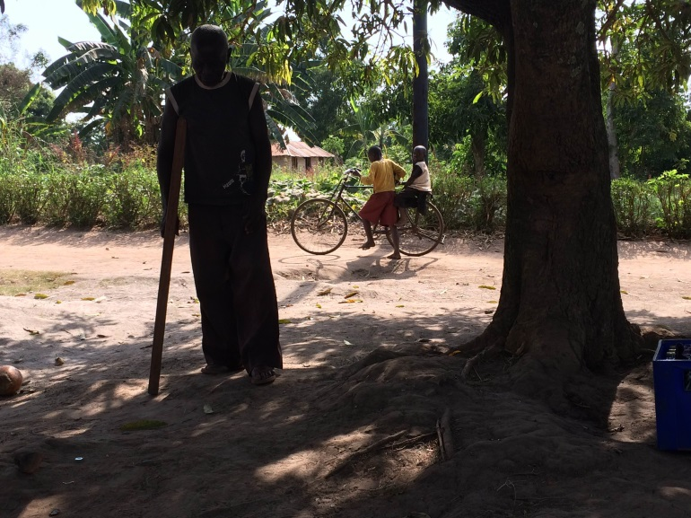
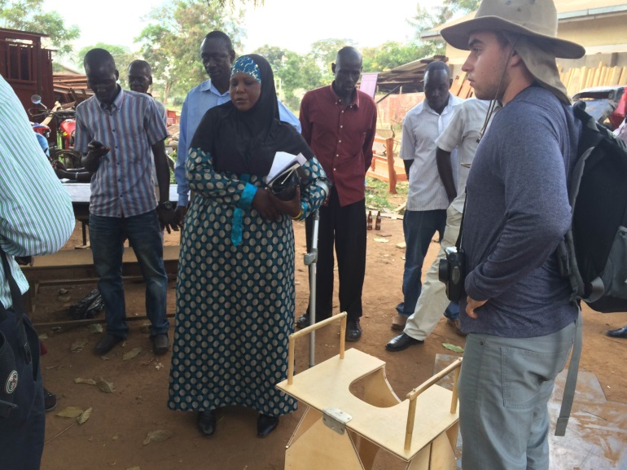
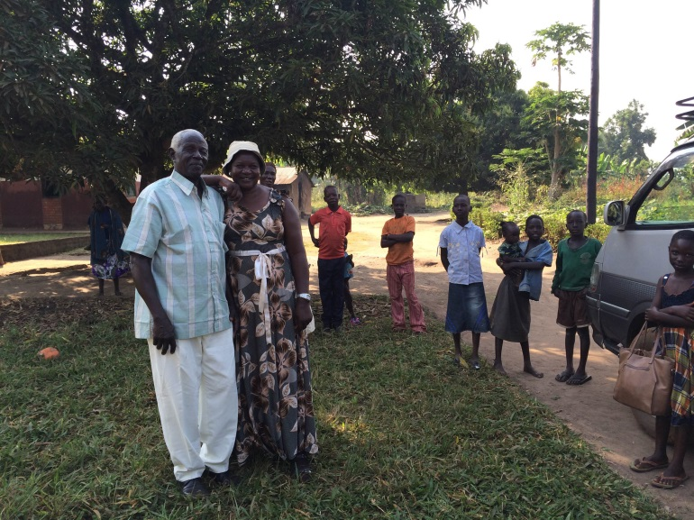
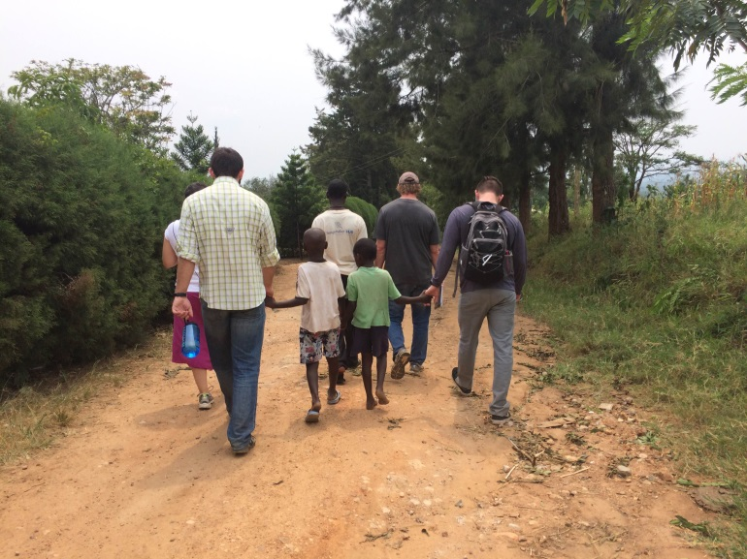
Our visit to Uganda

Slide 9
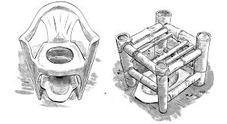
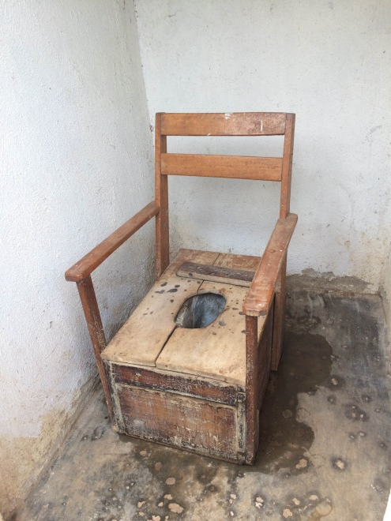
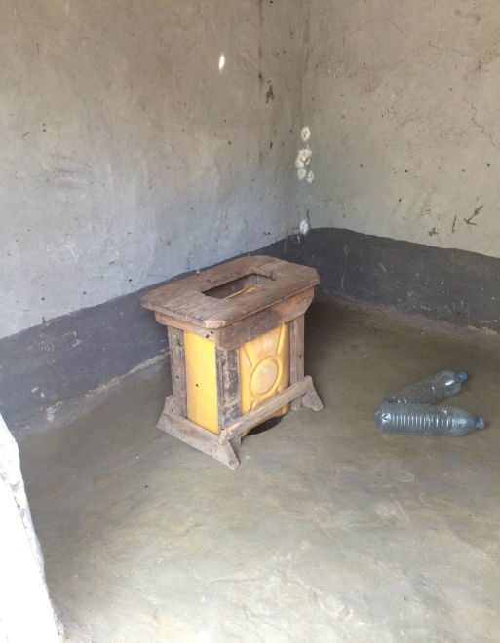
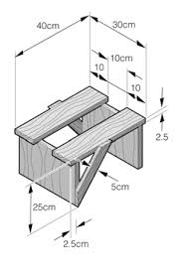
Their Solutions

Slide 10
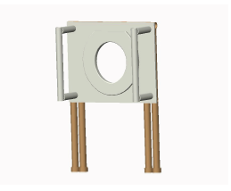
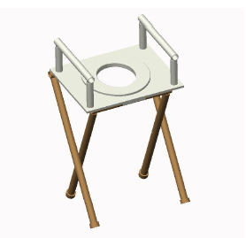
Current Prototypes
The Foldable Chair

Slide 11
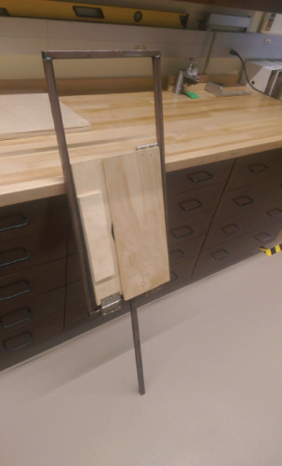
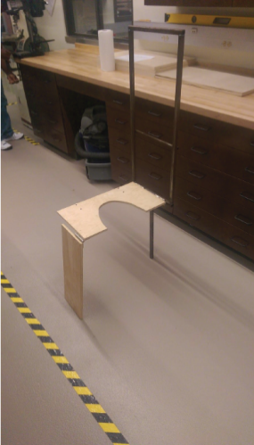
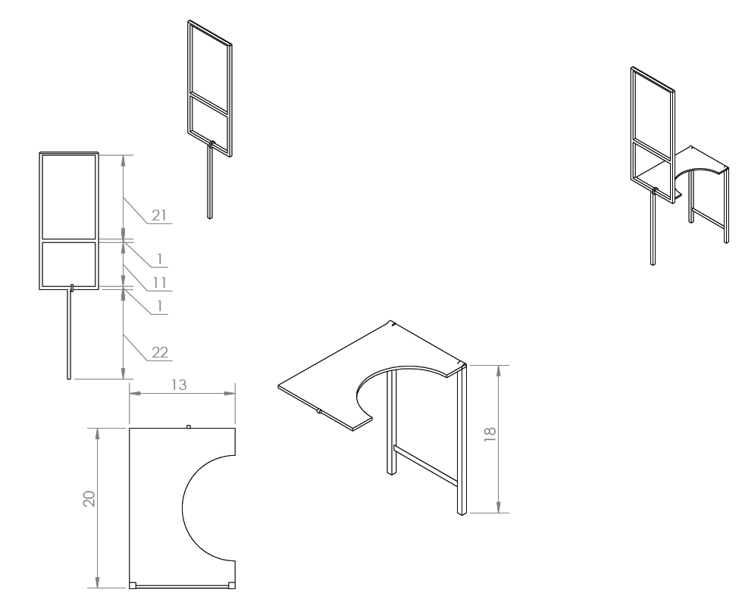
Current Prototypes
The Crutch

Slide 12
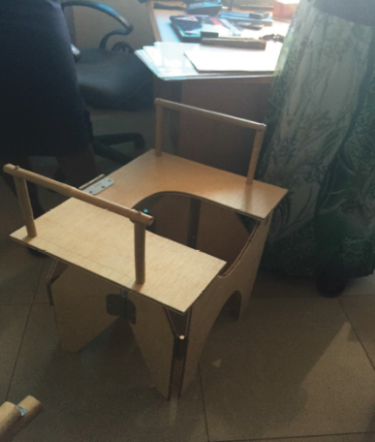
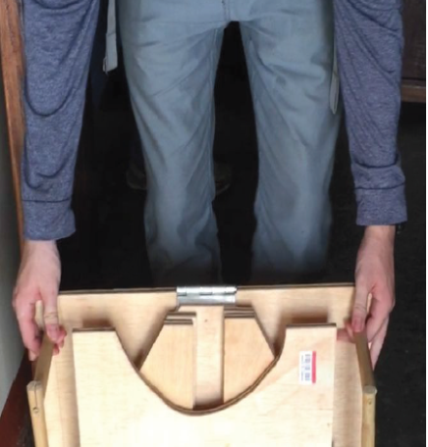
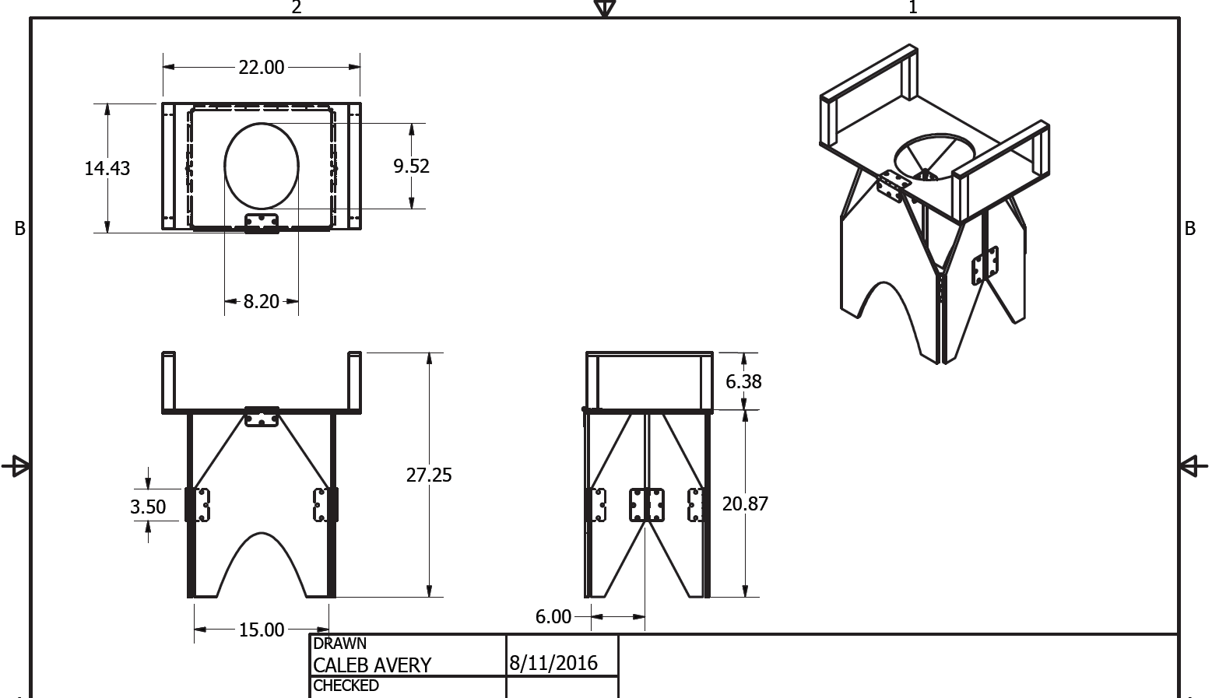
Current Prototypes
The Box

Slide 13
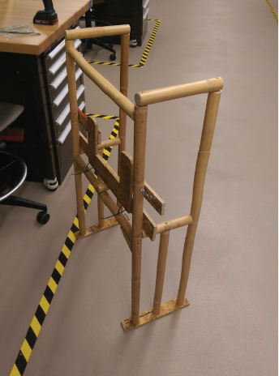
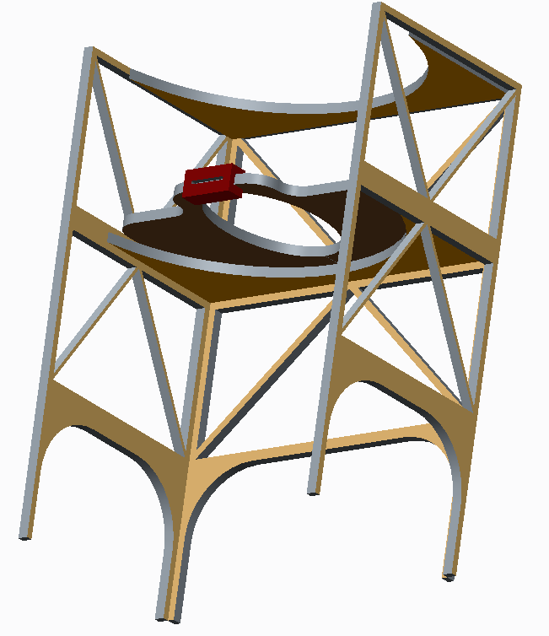
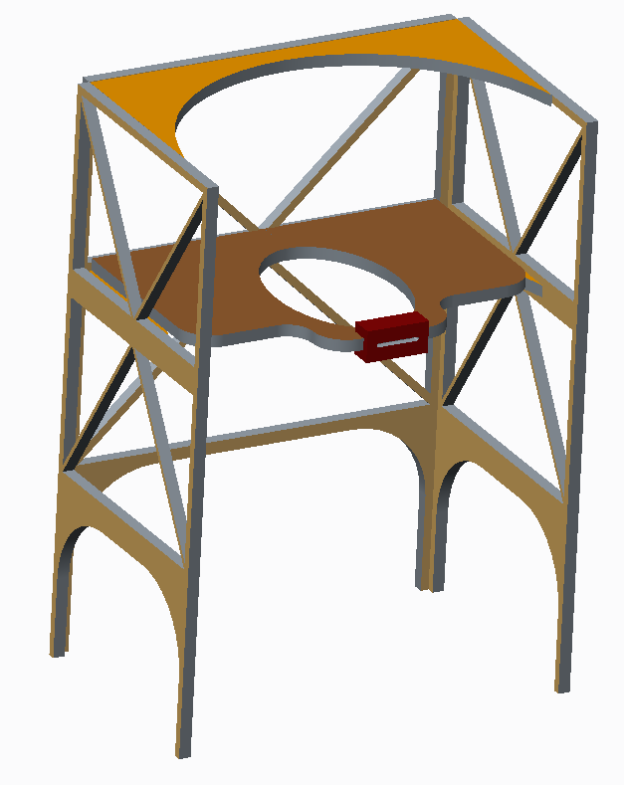
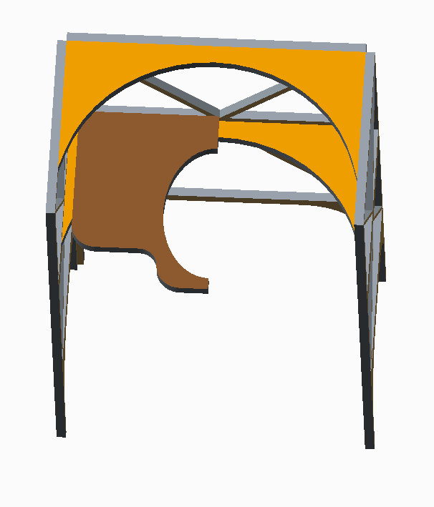
Current Prototypes
The Walker

Slide 14
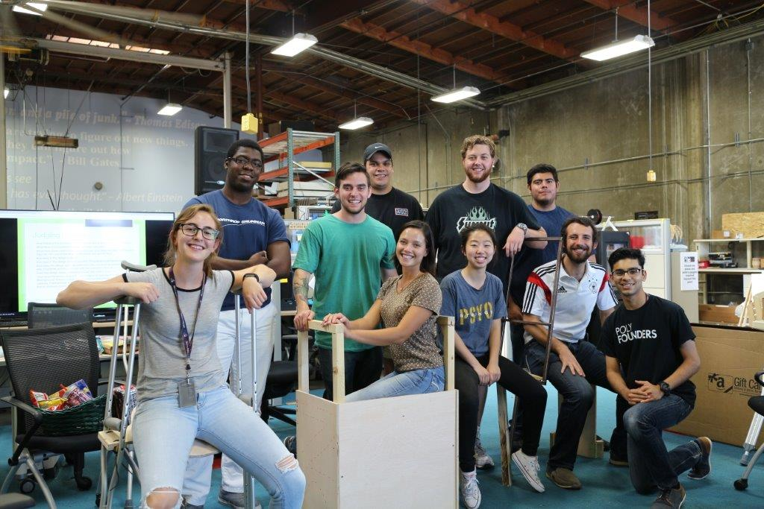
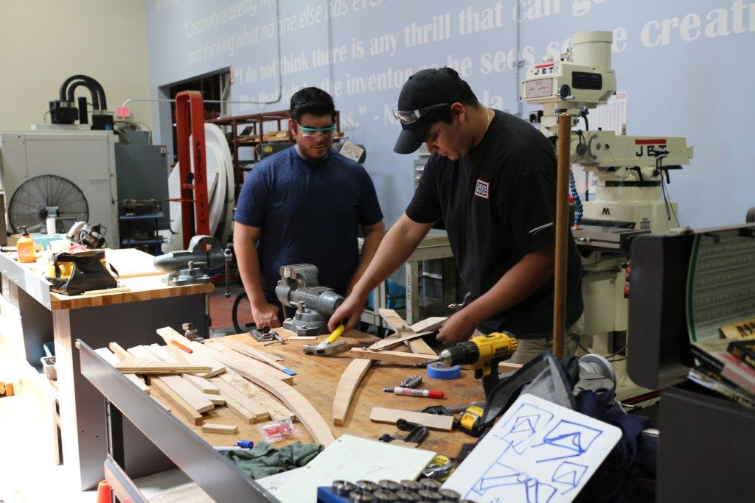
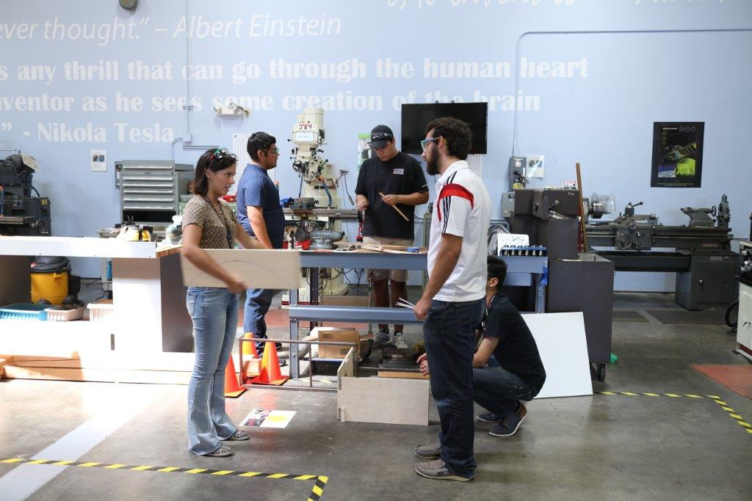
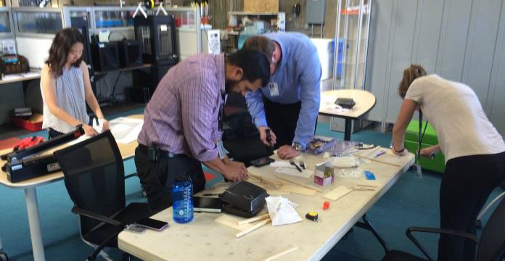
Simple Seat HACKATHON

Slide 15
What’s Next?
Senior Design Project will finalize the prototypes and create pictorial manuals
Fundraising for the Pilot Program:
https://www.generosity.com/medical-fundraising/simple-seat-better-lives/x/11800231
Implementation this January

Slide 16
Thanks for listening!

